Slide 1

Exercise 5 - Process Mining: Analysis and Modelling of a Loan Application Process through Process Mining and Large Language Models
Saccotelli Leonardo - 761047

Slide 2

Introduction
Process mining is a powerful technique that bridges data science and business process management by extracting process-related knowledge from event logs.
In this work we focus on analyzing and modeling a loan application process through process mining techniques and large language models (LLMs).

Slide 3
Dataset Overview
The event log selected in this work contains events related to an application process. The event log is hosted on 4TU.ResearchData platform in XES format.
Process description: An application is submitted through a webpage. Then, some automatic checks are performed, after which the application is complemented with additional information. This information is obtained trough contacting the customer by phone. If an applicant is eligible, an offer is sent to the client by mail. After this offer is received back, it is assessed. When it is incomplete, missing information is added by again contacting the customer. Then a final assessment is done, after which the application is approved and activated.

Slide 4
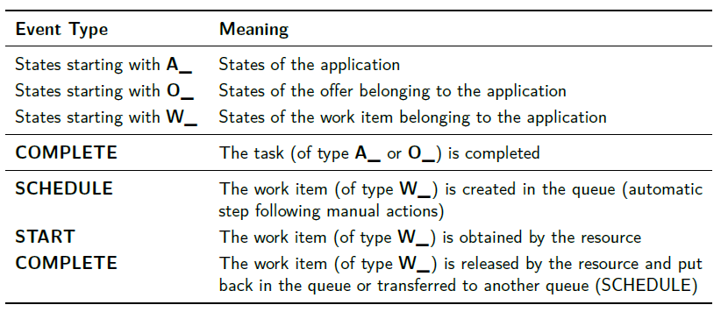
Dataset Overview
The event log counts 13087 different traces and a total of 262200 events. Each trace in the event log contains the following attribute:
case:concept:name - Unique ID of the trace;
case:REG_DATE - Starting date and time of the trace;
case:AMOUNT_REQ - The total amount of money requested.
Then, for each trace, we have a set of events, each of them with the following fields:
concept:name - Name of the event;
lifecycle:transition - State of the event;
org:resource - ID of the resource involved in the event;
time:timestamp - Date and time of the event.
In this work, we focus on activity of type A_ and O_ separately and then on a complete event log (AO_).

Slide 5
Methods
Alpha Miner algorithm is one of the earliest process discovery techniques. It identifies causal dependencies between activities based on directly followed relationships in the event log. Alpha Miner struggles with noise and complex routing behaviors, such as invisible transitions and loops.
Heuristics Miner algorithm extends the Alpha Miner by considering the frequency of events and traces for reconstructing a process model, disregarding infrequent paths to manage complexity. It introduces thresholds to filter infrequent behavior, which helps in managing noisy event logs. The Heuristic Miner is more robust than Alpha Miner, making it suitable for real-life event logs where noise and incomplete traces are present.
Inductive Miner algorithm generates process models by recursively decomposing an event log into smaller parts. It ensures sound and structured process models by following a divide-and-conquer approach.

Slide 6
Metrics Evaluation
Fitness measures how well a discovered process model can replay the event log, which means how much of the observed behavior is allowed by the model. A high fitness score indicates that most observed traces in the log can be executed in the model.
Precision describes how much of the behavior allowed by the model is present in the log. A model with high precision does not allow for excessive, unobserved behavior. A model with low precision means that it generally allows a lot of behavior that is not part of the log.
Generalization assesses the ability of a process model to handle unseen cases while maintaining its correctness. It describes the likelihood that future behavior will already be executable in the model. Overfitting to the event log can lead to poor generalization.
Simplicity ensures that the discovered process model is not overly complex. A simpler model is preferable as it is easier to understand and maintain but, at the same time, it often lacks in precision and/or fitness.

Slide 7



LLMs & LVLMs
Large Language Models (LLMs) and Large Vision Language Models (LVLMs) have been used to enhance process mining understanding.
We leverage pm4py.llm library and methods to generate abstractions of cases, process variants, and petri nets.
These abstractions are then used to construct prompts for gemini-1.5-pro and gemini-1.5-flash, asking it to explain the process derived from different representations (textual and visual).

Slide 8
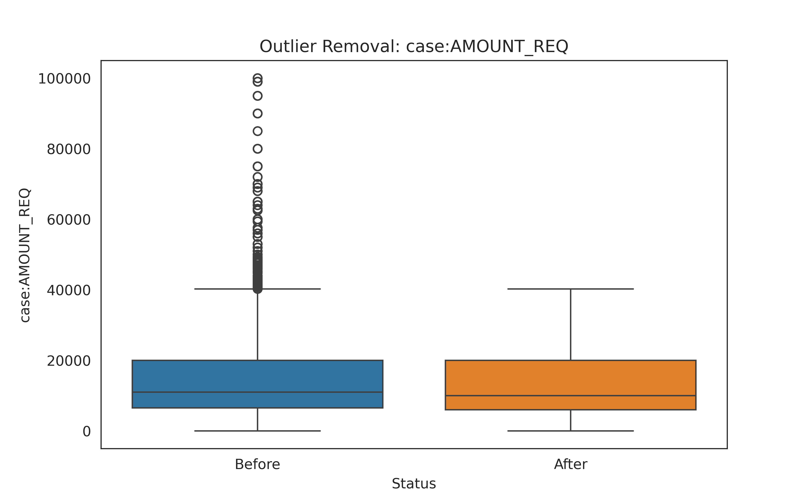
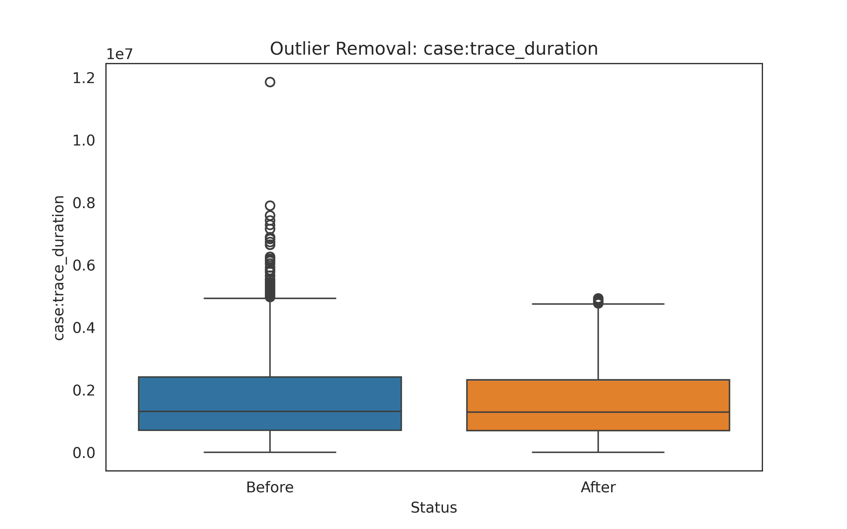
Data preprocessing
data type conversion - conversion of the field case:AMOUNT_REQ from object to numeric;
removing null data - removing all the event for which the org:resource was null (18010 events removed);
removing duplicated data - check of duplicated traces or events in trace (0 events removed);
removing outliers - check the presence of outliers in terms of case:AMOUNT_REQ (13342 events removed) and case:trace_duration (4305 events removed).
The event log after the preprocessing phase counts 226543 different events.

Slide 9
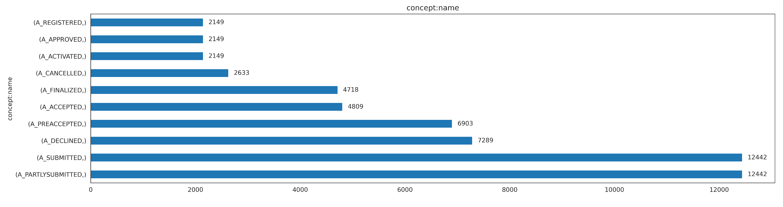
Application Event Log
Event frequency analysis performed to identify both rare and dominant events.
Rare threshold (1%, 577 occurencies) - Dominant threshold (10%, 5768 occurencies)
No events in the dataset fell below the rare threshold of 1%, indicating that all activities occur with sufficient frequency to be considered statistically relevant.
Four events surpassed the dominant threshold of 10%, signifying that they appear disproportionately often compared to other activities.
A_PARTLYSUBMITTED (12442 occurrences, 21.6%)
A_SUBMITTED (12442 occurrences, 21.6%)
A_DECLINED (7289 occurrences, 12.6%)
A_PREACCEPTED (6903 occurrences, 11.9%)
The dominance of A_PARTLYSUBMITTED and A_SUBMITTED indicates that submission-related activities are the most recurrent, possibly reflecting a high volume of applications or transactions.

Slide 10
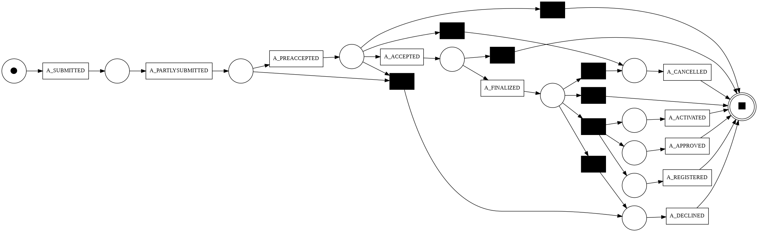
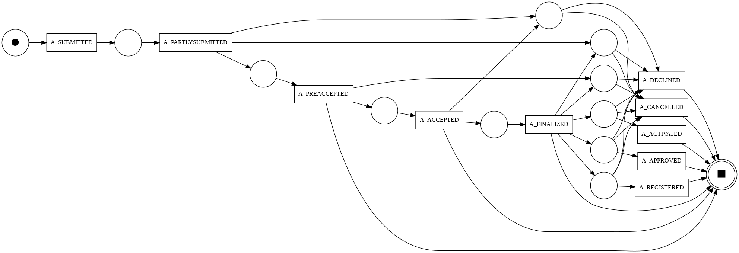
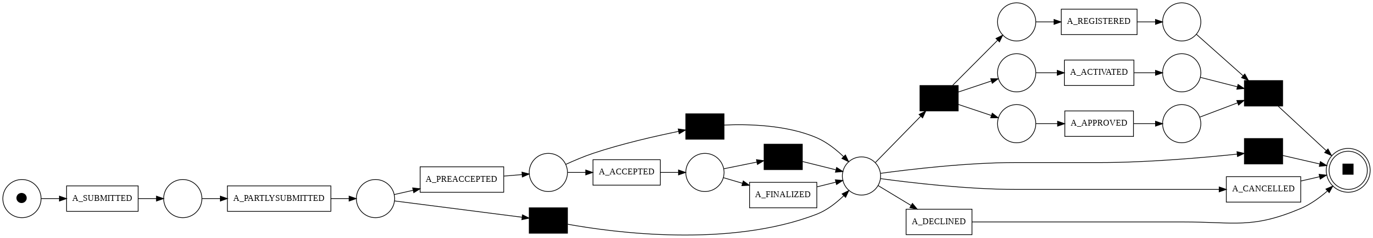
Application Event Log
Alpha Miner
Heuristics Miner
Inductive Miner

Slide 11
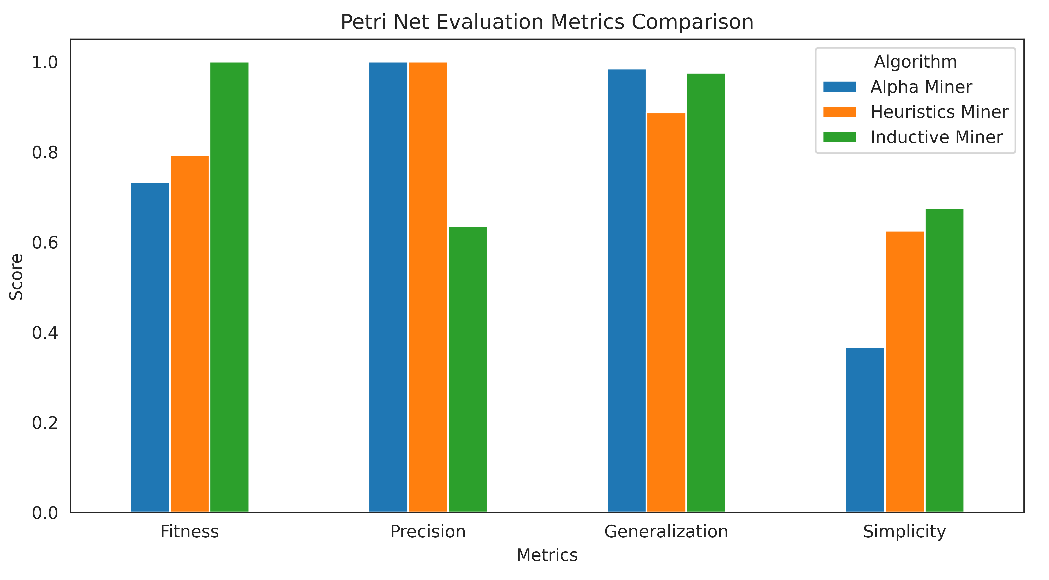
Application Event Log
Alpha Miner achieves high precision, ensuring strict adherence to the log but at the cost of lower fitness, as it fails to capture all behavioral variations.
Heuristics Miner balances fitness and generalization, capturing key process patterns while handling noise better than Alpha Miner.
Inductive Miner achieves perfect fitness, capturing all variations in the log while maintaining high generalization. This makes it robust for predictive applications. It also produces the simplest models, enhancing interpretability.
 | Fitness | Precision | Generalization | Simplicity
Alpha | 0.70 | 1.00 | 0.98 | 0.37
Heuristics | 0.79 | 1.00 | 0.89 | 0.63
Inductive | 1.00 | 0.65 | 0.98 | 0.67

Slide 12
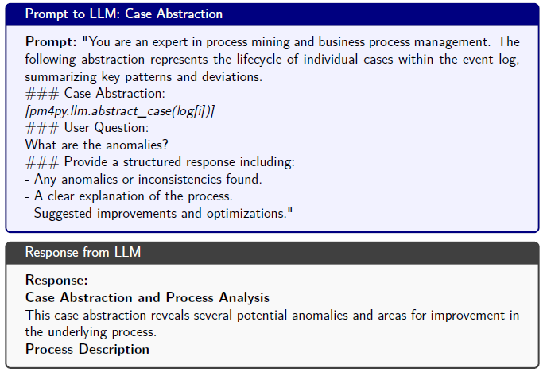
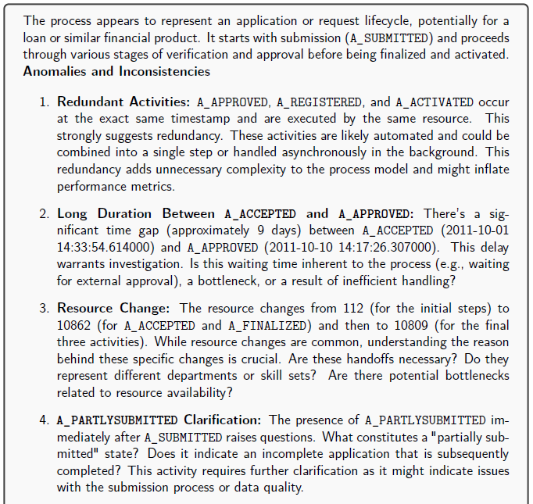
Application Event Log + LLMs (Case abstraction) 1/2

Slide 13
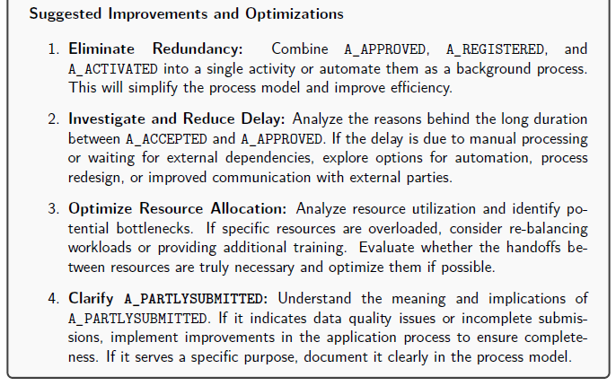
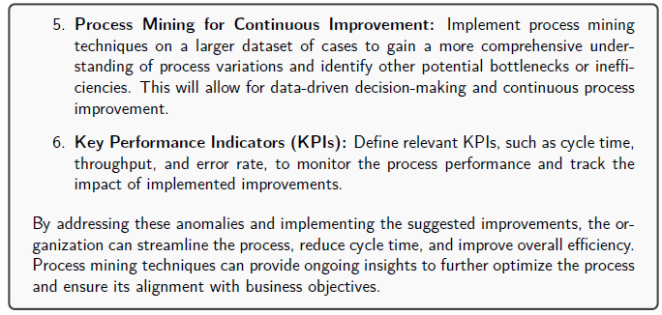
Application Event Log + LLMs (Case abstraction) 2/2

Slide 14
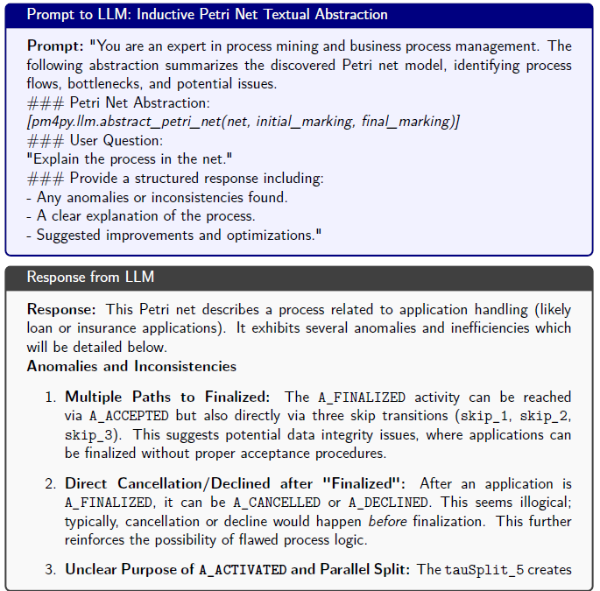
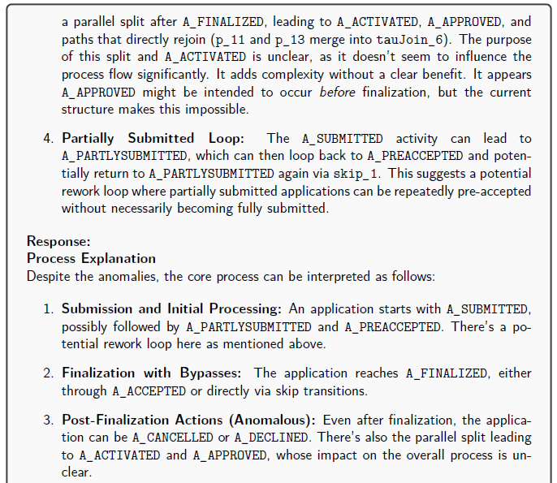
Application-Offer Event Log + LLMs (Inductive Petri Net Textual abstraction) 1/2

Slide 15
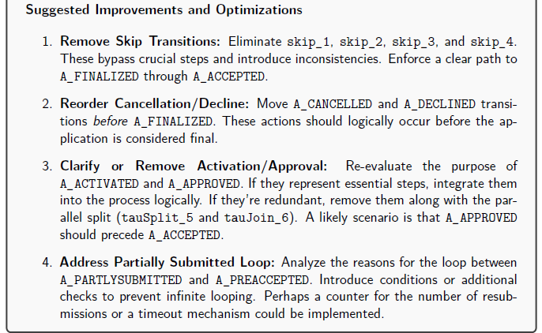
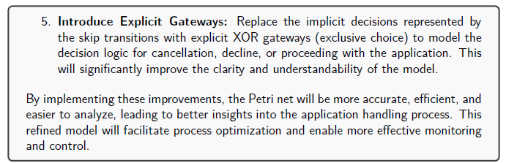
Application-Offer Event Log + LLMs (Inductive Petri Net Textual abstraction) 1/2

Slide 16
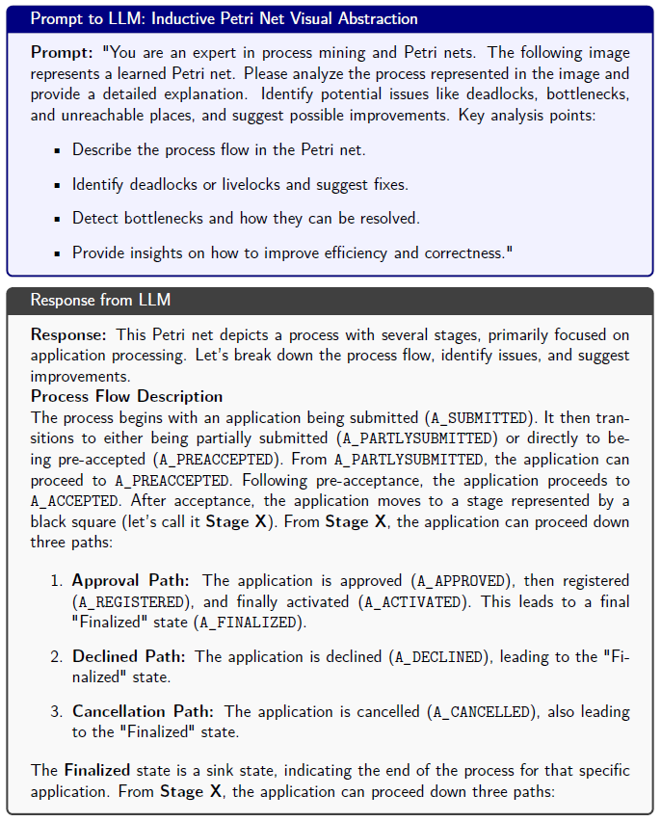
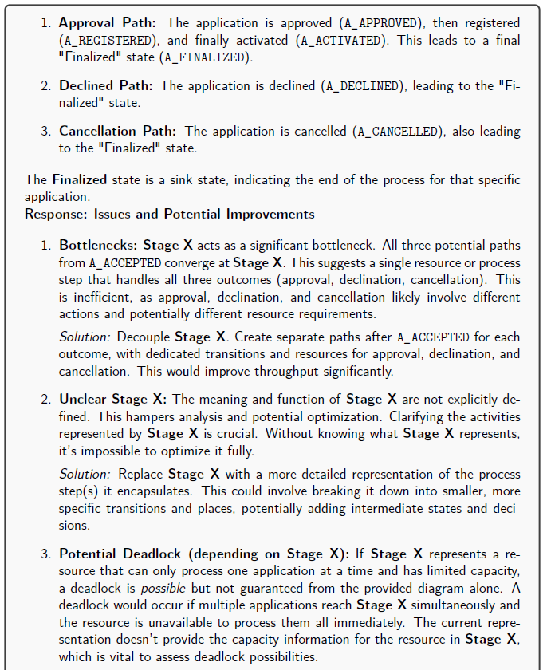
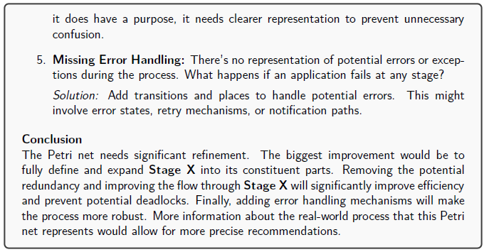
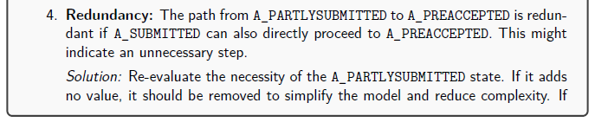
Application-Offer Event Log + LLMs (Inductive Petri Net Visual abstraction)

Slide 17
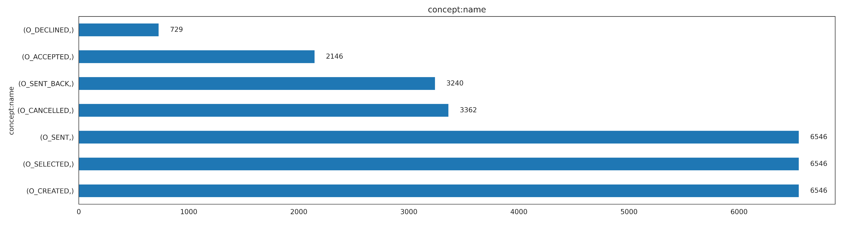
Offer Event Log
Event frequency analysis performed to identify both rare and dominant events.
Rare threshold (1%, 291 occurencies) - Dominant threshold (10%, 2912 occurencies)
No events in the dataset fell below the rare threshold of 1%, indicating that all activities in the offer process occur with sufficient frequency to be considered statistically relevant.
Five events surpassed the dominant threshold of 10%, highlighting their critical role in the process:
O_CREATED (6546 occurrences, 22.5%)
O_SELECTED (6546 occurrences, 22.5%)
O_SENT (6546 occurrences, 22.5%)
O_CANCELLED (3362 occurrences, 11.5%)
O_SENT_BACK (3240 occurrences, 11.1%)

Slide 18
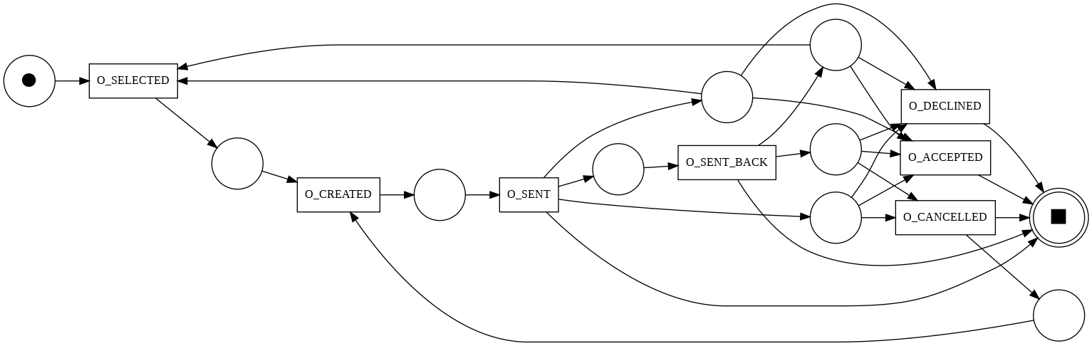
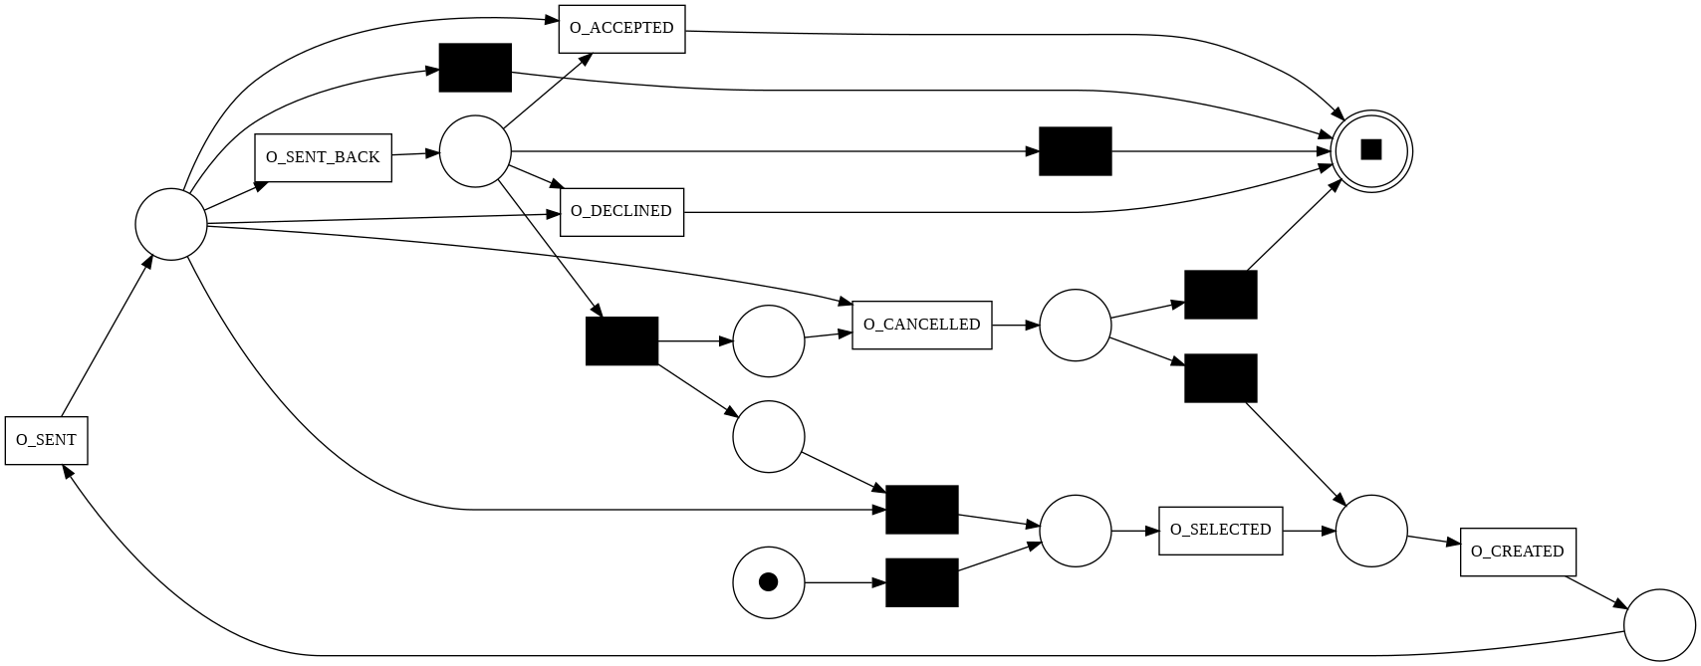
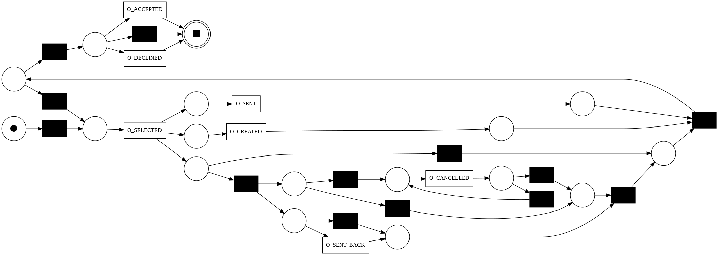
Offer Event Log
Alpha Miner
Heuristics Miner
Inductive Miner

Slide 19
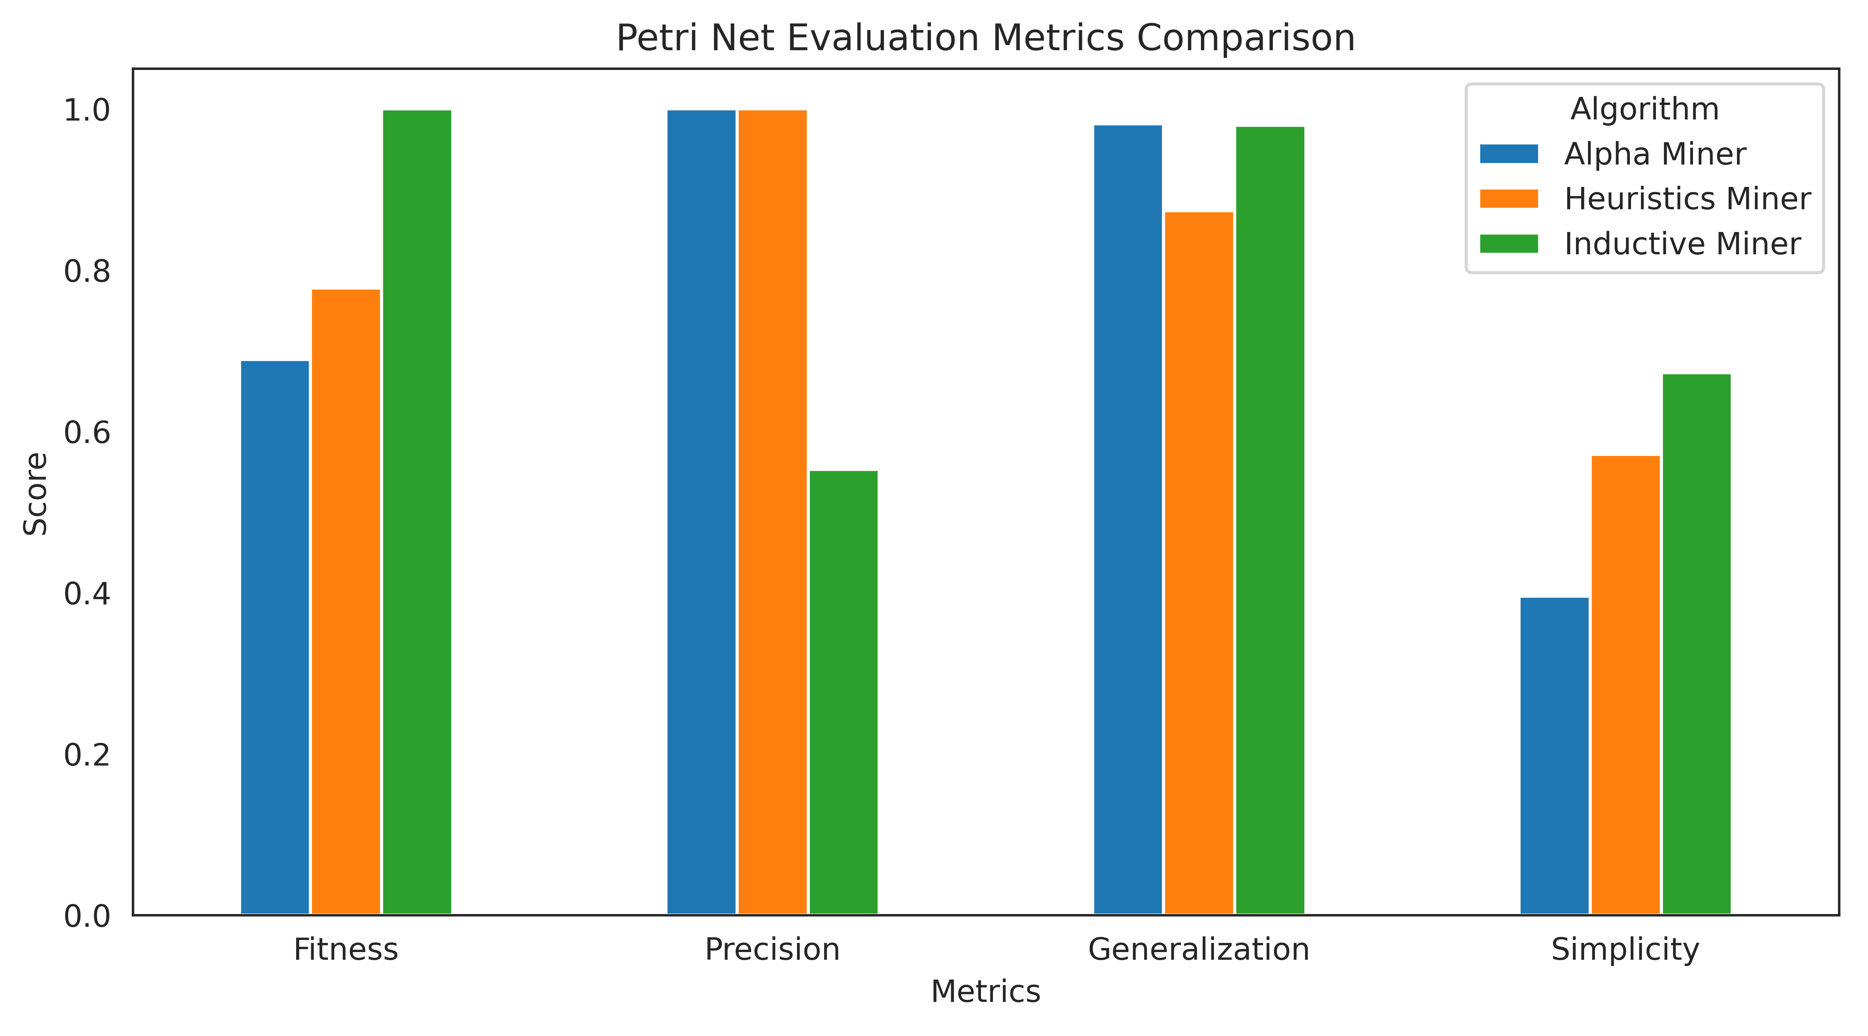
Offer Event Log
Alpha Miner achieves high precision, ensuring that all discovered edges are correct. However, its lower fitness and generalization indicate an incomplete representation of the process.
Heuristics Miner improves fitness over Alpha Miner while maintaining a balanced generalization. However, lower simplicity suggests a more intricate model.
Inductive Miner delivers perfect fitness, capturing all process variations with high generalization but suffers from lower precision. It performs best overall due to its superior fitness, making it preferable for complex processes.
 | Fitness | Precision | Generalization | Simplicity
Alpha | 0.69 | 1.00 | 0.98 | 0.40
Heuristics | 0.78 | 1.00 | 0.87 | 0.57
Inductive | 1.00 | 0.55 | 0.98 | 0.67

Slide 20
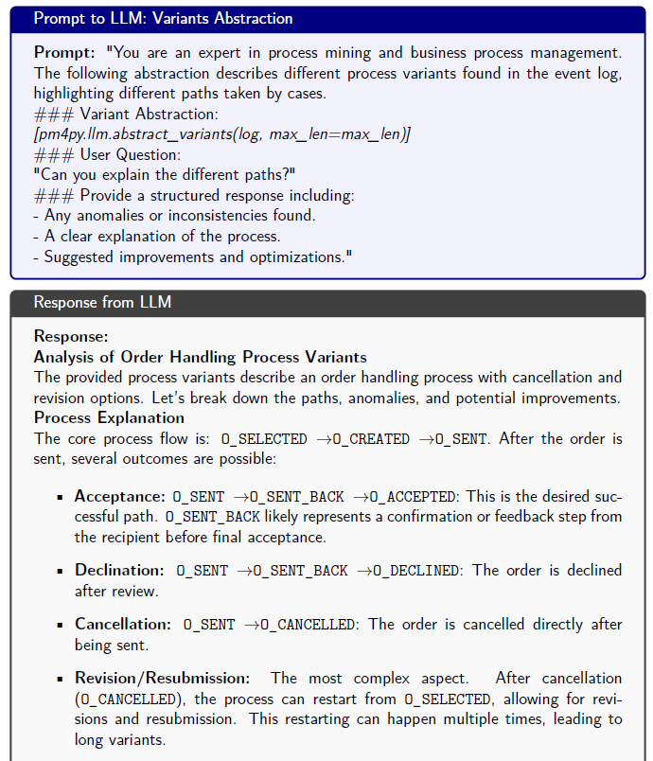
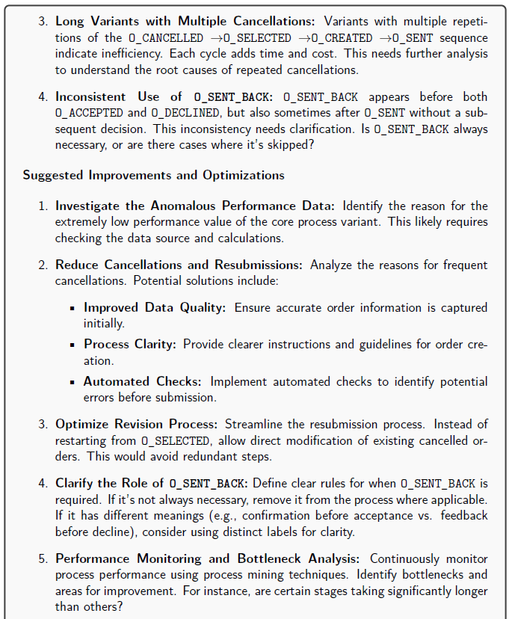
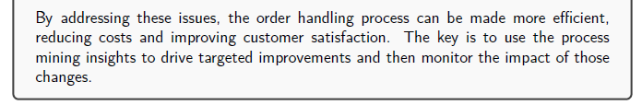
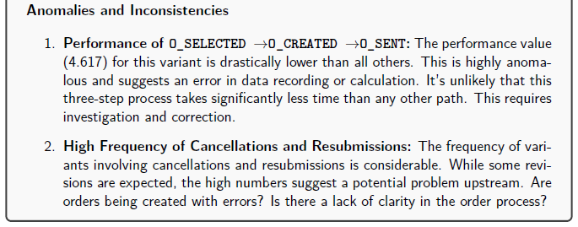
Offer Event Log + LLMs (Variants abstraction)
Variants refer to unique sequences of activities (traces) observed in an event log. Each variant represents a specific way in which a process instance (or case) was executed.

Slide 21
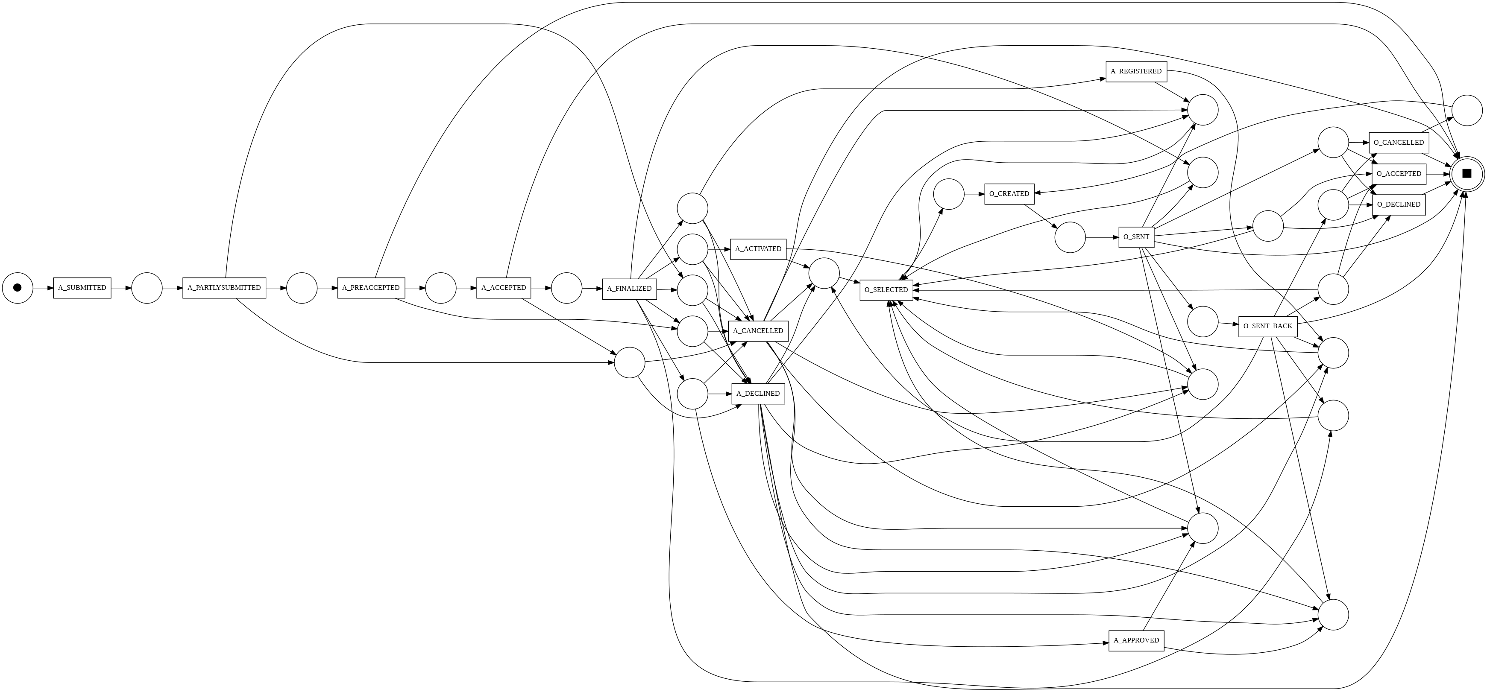
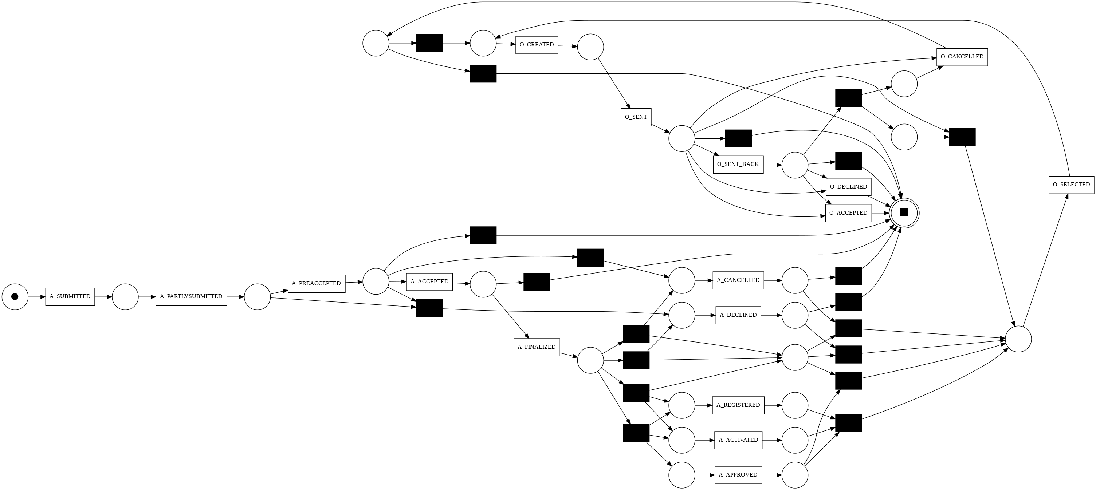
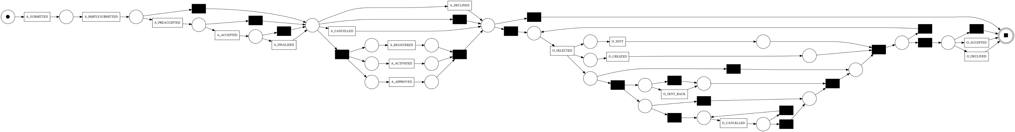
Application - Offer Event Log
Alpha Miner
Heuristics Miner
Inductive Miner

Slide 22
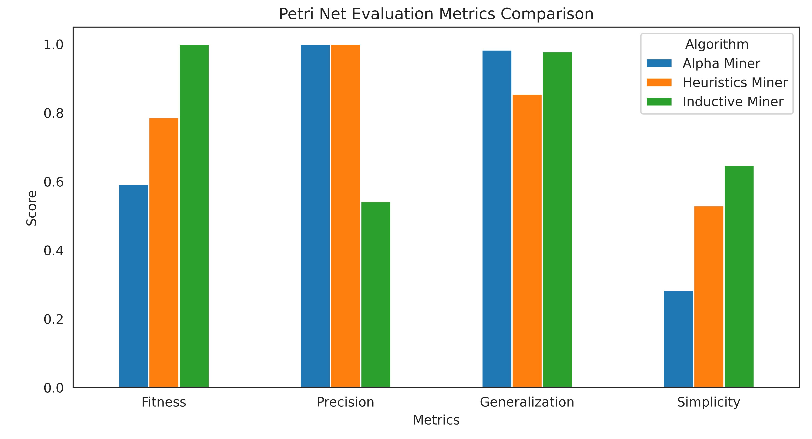
Application - Offer Event Log
Alpha Miner offers high precision and strong generalization but struggles with low fitness and low simplicity, leading to complex models.
Heuristics Miner provides the best fitness and high precision but has lower generalization and moderate simplicity. It is recommended when fitness and precision are crucial, and a moderate level of complexity is acceptable.
Inductive Miner emerges as the best performer, excelling in fitness and generalization. However, Heuristics Miner offers a balanced trade-off, while Alpha Miner remains ideal for high-precision needs.
 | Fitness | Precision | Generalization | Simplicity
Alpha | 0.59 | 1.00 | 0.98 | 0.28
Heuristics | 0.79 | 1.00 | 0.88 | 0.53
Inductive | 1.00 | 0.54 | 0.98 | 0.65

Slide 23
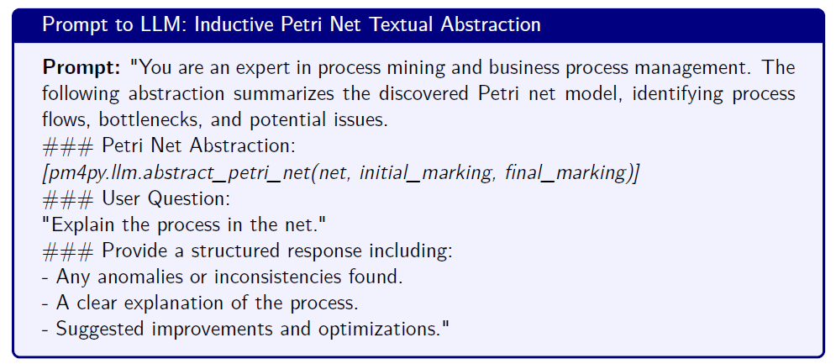
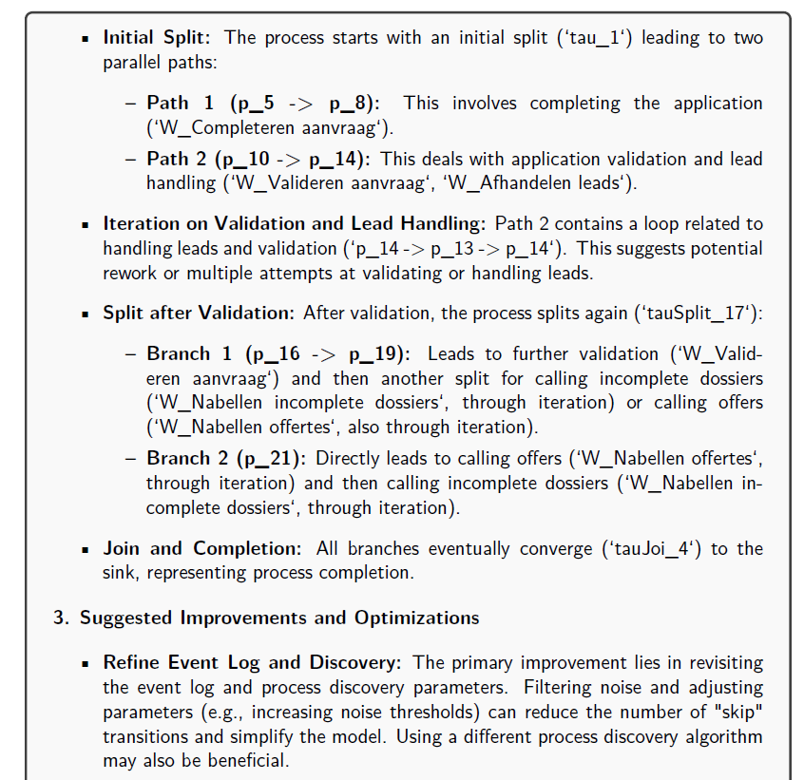
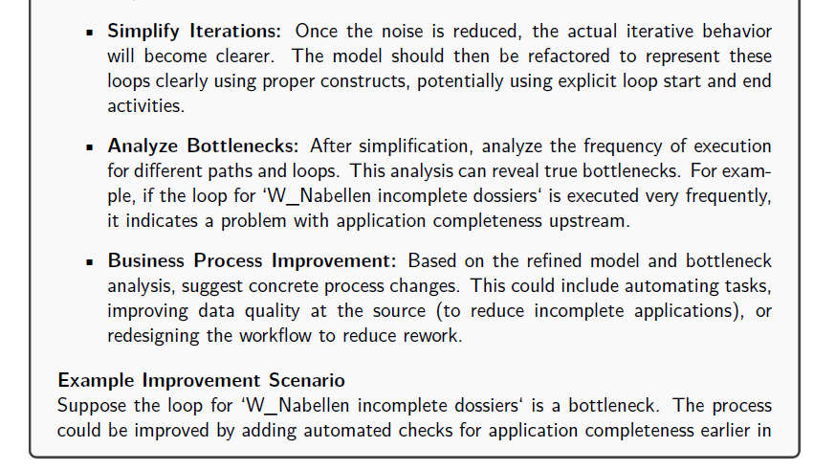
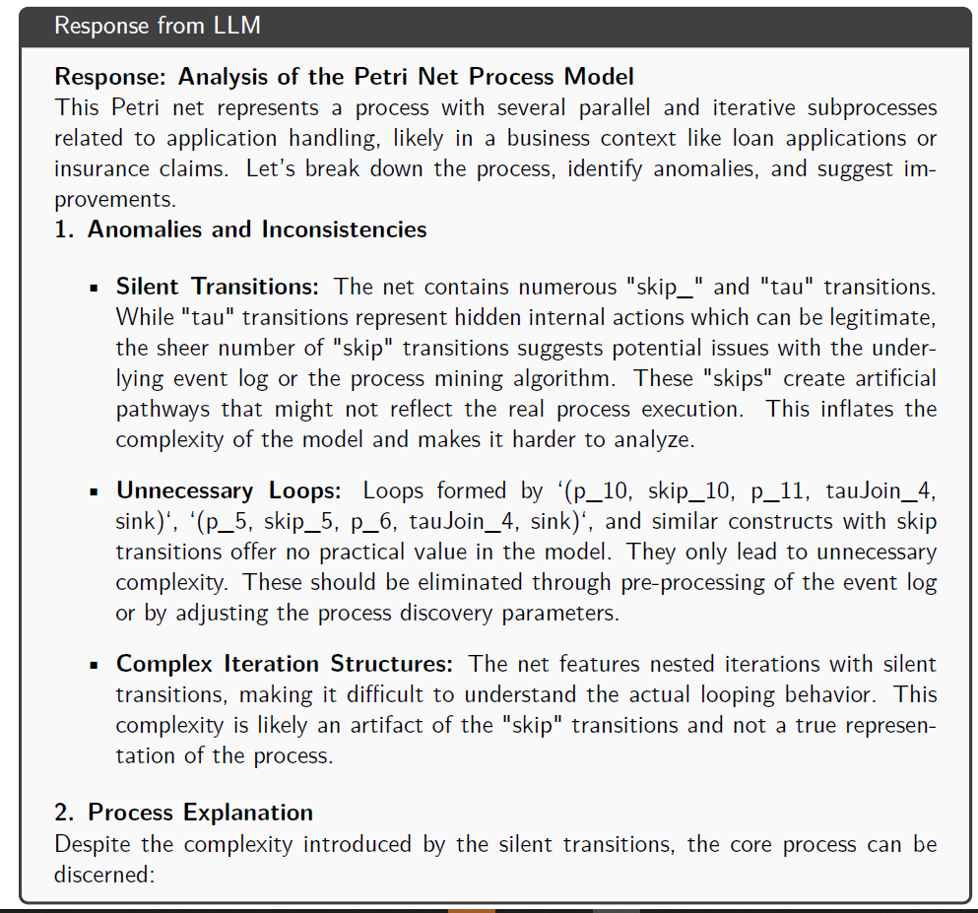
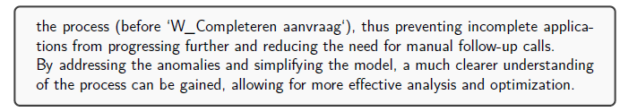
Application-Offer Event Log + LLMs (Inductive Petri Net Textual abstraction)

Slide 24
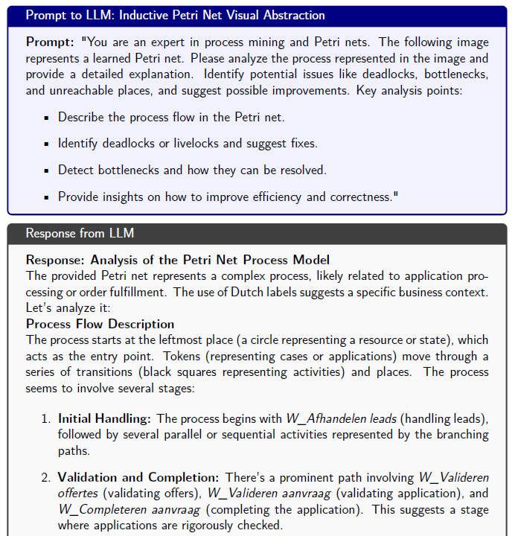
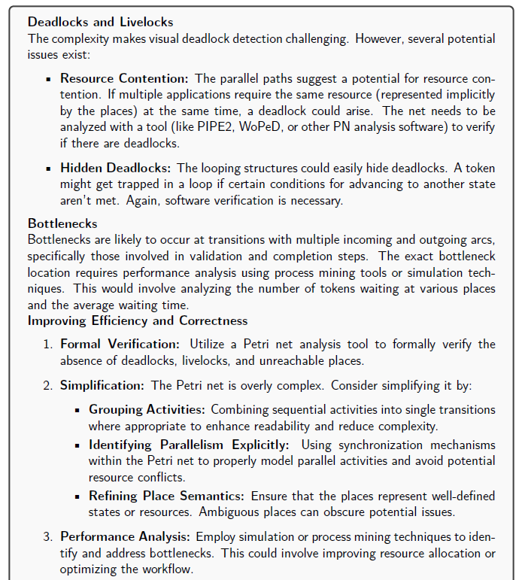
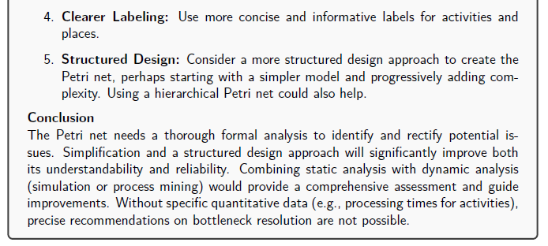
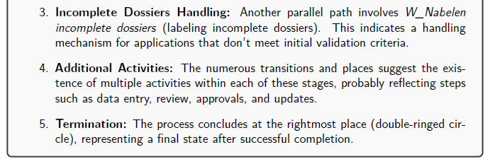
Application-Offer Event Log + LLMs (Inductive Petri Net Visual abstraction)

Slide 25
Conclusion & Future Works
This study demonstrates the effectiveness of process mining in analyzing and optimizing a loan application process by extracting process models from event logs and evaluating their performance.
The comparison of Alpha Miner, Heuristics Miner, and Inductive Miner highlights trade-offs between precision, fitness, and generalization, with Inductive Miner proving to be the most versatile for capturing complex process dynamics.
The integration of large language models further enhances process mining by providing automated textual and visual explanations of process behaviors, anomalies, and improvement suggestions. This approach improves the interpretability of discovered models and supports decision-making in process optimization.

Slide 26

Thank for the attention Formal methods for computer science Prof. Berardina De Carolis Università degli studi di Bari Aldo Moro Computer Science
Leonardo Saccotelli
l.saccotelli@studenti.uniba.it

